Slide 1
Python BE Codeathon Challenge
NAME : Seerapu Divya Reddy

Slide 2

CONTENTS
TITLE
PROJECT OVERVIEW
PROJECT STRUCTURE
KEY TECHNOLOGIES
USER AUTHENTICATION FLOW
RBAC IMPLEMENTATION
CRUD OPERATIONS
API ENDPOINTS
APPLICATION FLOW
TESTING WITH POSTMAN
KEY TAKEWAYS

Slide 3
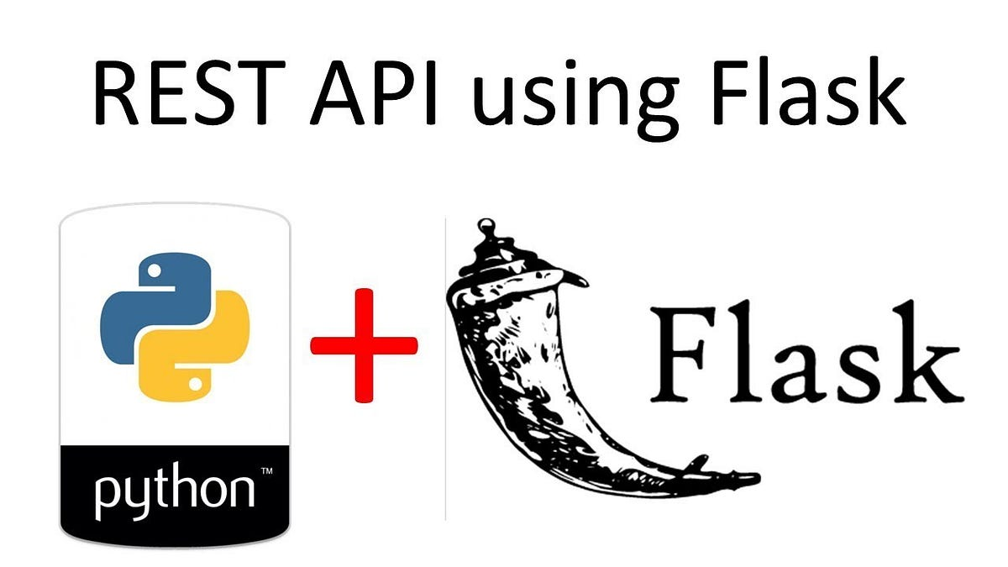
Title : Role-Based Access Control (RBAC) Flask Application
This project implements a secure REST API with JWT authentication, MongoDB for data storage, and role-based permissions.
It handles multiple objects and allows CRUD operations while maintaining data security and access control.

Slide 4
Project Overview
Flask-based REST API
MongoDB for data storage
JWT Authentication for security
CRUD operations on two object models: Organisation and Employee
Role-Based Access Control (RBAC)
Role 1: Create & Read
Role 2: Create, Read & Update
Role 3: Full CRUD Access
The main objective of this project is to securely manage data by implementing Role-Based Access Control.
I have designed the API with two core models:
Organisation – This could be a company, college, or community.
Employee – Each employee is linked to a particular organisation.
Users are authenticated using JWT tokens, and access is controlled based on their assigned role.

Slide 5
Project Structure
rbac-flask-app/
├── app.py # Main Flask application
├── models.py # Organisation & Employee models (CRUD)
├── rbac.py # Role-Based Access Control
├── config.py # Configuration (MongoDB URI & JWT key)
└── requirements.txt # Required packages
app.py – This is the main Flask application where I define routes and link all components.
models.py – This file manages the CRUD operations for both Organisation and Employee.
rbac.py – This handles role-based access and secures endpoints.
config.py – Stores configuration values like the MongoDB URI and JWT secret key.

Slide 6
Key Technologies
Flask – Web framework for creating APIs
Flask-JWT-Extended – For secure JWT authentication
Flask-PyMongo – MongoDB integration for storing and retrieving data
Postman – For testing CRUD operations
I used these core technologies:
Flask – Lightweight and fast for building RESTful APIs.
Flask-JWT-Extended – Handles secure authentication through JWT tokens.
Flask-PyMongo – Connects to MongoDB, allowing CRUD operations.
Postman – To test the endpoints and validate responses.

Slide 7
User Authentication Flow
User Logs In → Sends username and password
If valid, generates a JWT token
JWT token is required for protected routes
Access depends on user role
The authentication process starts when a user logs in using their username and password.
If the credentials are correct, a JWT token is generated and returned.
This token is then used to access protected resources based on their role.

Slide 8
RBAC Implementation
from functools import wraps
from flask_jwt_extended import get_jwt_identity, jwt_required
from flask import jsonify
def role_required(required_role):
def decorator(fn):
@wraps(fn)
@jwt_required()
def wrapper(*args, **kwargs):
identity = get_jwt_identity()
role = identity.get("role")
if role != required_role:
return jsonify({"msg": "Forbidden"}), 403
return fn(*args, **kwargs)
return wrapper
return decorator
It first authenticates the user through a JWT token.
It then verifies the user's role and grants or denies access to specific routes.

Slide 9
CRUD Operations
CRUD Operations for Organisation and Employee
Create – Insert new records
Read – Retrieve all records
Update – Modify existing records
Delete – Remove records
I have implemented full CRUD functionality for both the Organisation and Employee models.
Depending on the user's role, they can Create, Read, Update, or Delete records.

Slide 10
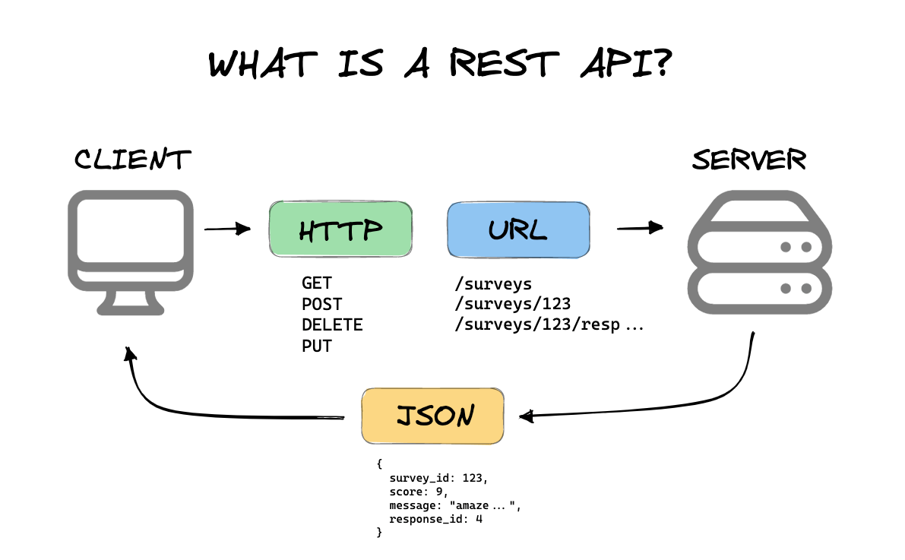
API Endpoints
Method Endpoint Permission Required
POST /login Public (Login)
GET /organisations Role 2, Role 3
POST /organisations Role 2, Role 3
PUT /organisations/:id Role 3 (Update)
DELETE /organisations/:id Role 3 (Delete)
GET /employees Role 3 (Read)
POST /employees Role 1, Role 2, Role 3

Slide 11
Application Flow
User Authentication – Get JWT Token
Access Control – Check Permissions
Perform CRUD – Based on Role
Secure Data – Store in MongoDB
Users first log in to receive a JWT token.
This token is validated on every request.
Based on the user's role, they can Create, Read, Update, or Delete records.
Data is securely stored in MongoDB.

Slide 12
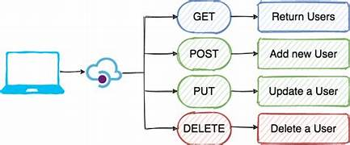
Testing with Postman
Authentication
Role-based access control
CRUD operations
Error handling for unauthorized access

Slide 13
Key Takeaways
Secure JWT Authentication
Role-Based Access Control (RBAC)
Full CRUD operations on MongoDB
Scalable and extensible design
This project demonstrates:
Secure API using JWT Authentication
RBAC for fine-grained access control
Full CRUD support on MongoDB
A modular, scalable structure for future expansion

Slide 14


